Slide 1
DEBRIS
Daniel, Miracle, Samir & Dhara

Slide 2
Discussion
The game is a spaceship that is on the left size of the screen is firing at aliens who are the enemies of the game, and they explode when hit also there is a high score tracker at the top of the screen that keeps score of the player that is playing, and they have a few lives at the bottom of the screen (3 lives for each player).

Slide 3
Creation platform
The platform that we are using to code this game is PyGame that allows the user to create any game they like, and it is easier to use than other applications that create games of our choice.

Slide 4
Programming language
The programming language we are using is Python because it’s easier to understand what is written and it’s less complicated compared to c#.
C# has more steps to python, and it's too time consuming whereas python doesn’t take long to code/write if you understand the programming language.

Slide 5
VS Code installation & setup
First go to google and type in the search bar vs code(visual studio code).
Then click on the vs code download website to start the downloading process.
Start downloading the application from the website once done open the download link to install the package.
Click on next to find a location on your drive and start the installation of the package (vs code).
Once the installation is completed click on the finish button.

Slide 6
PyGame initialisation
First go to vs code and open a new terminal.
Then in the terminal type ‘pip install pygame’ to install pygame on vs code application.
This line of code also checks if the application is already there if not it will throw an error in the terminal.
If the application isn’t on vs code, then you need to open the Windows PowerShell application and type the same thing as vs code.(‘pip install pygame’)
Once you type this line of code it will install pygame on your machine.
After that go back to vs code and retype the line of code in a new terminal and run it again and this time it should install the package on vs code.

Slide 7
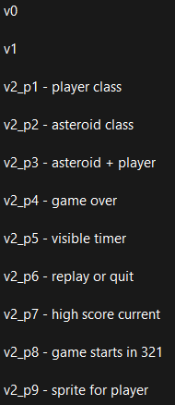
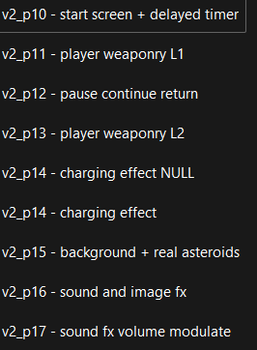
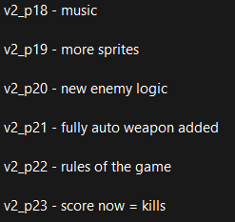
Iterations of and additions to the game
V = version
P = part

Slide 8
VS Code/PyGame libraries
These libraries are used in vs code and pygame:
To increase portability, switching from hardcoding paths to:-
game_path = os.path.dirname(__file__)
game_assets = os.path.join(game_path)
Placing all files in subdirectories within game directory

